Slide 1
Enhancing the Lives of Working Women
Team: Femme (Taylore G., Kendall T., Tiffany L. Timi A.)
i
Notes:
Team intro
Femme
Names
domain : enhancing lives of working women

Slide 2




Recap
“Ella”
“Grace”
“Tamara”
“Maria”
The software engineer turned stay-at-home Mom
The first year out of Stanford Engineer
The business owner hair stylist
The Zoom PWR professor

Slide 3
POV: Ella
1
We Met Ella….
3
We wonder if this means…
2
We were surprised to notice…
4
It would be game changing to
a software engineer turned stay-at-home mom.
Having autonomy /variability in life is at odds with being a mother
she lives a routine and monotonous life.
empower mothers of young kids to have ownership of their own time and interests

Slide 4

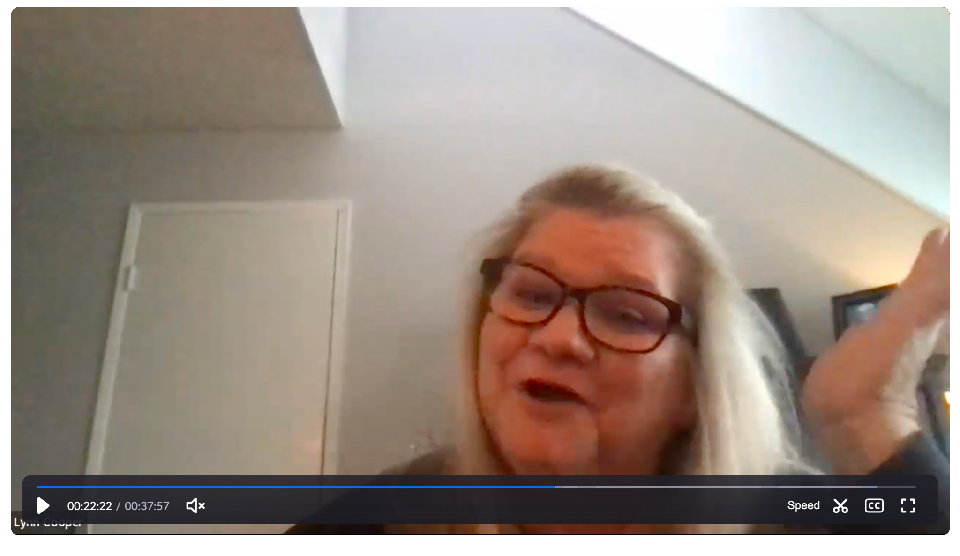
“Charlie”
Q1 - “My husband is amazing and is really involved and hands on with [kid] and her sports which has really given me a lot of time to myself”
Q2 - “Morning are the best part of my day. It’s quiet, I drink my cup of tea and relax, maybe read a magazine and no one is calling me mom”
Notes:
Last week we thought the mother and working women conversations were interesting so we looked for more candidates in those categories. Mother of 2, part time educator, moves around a lot bc of coast guard

Slide 5
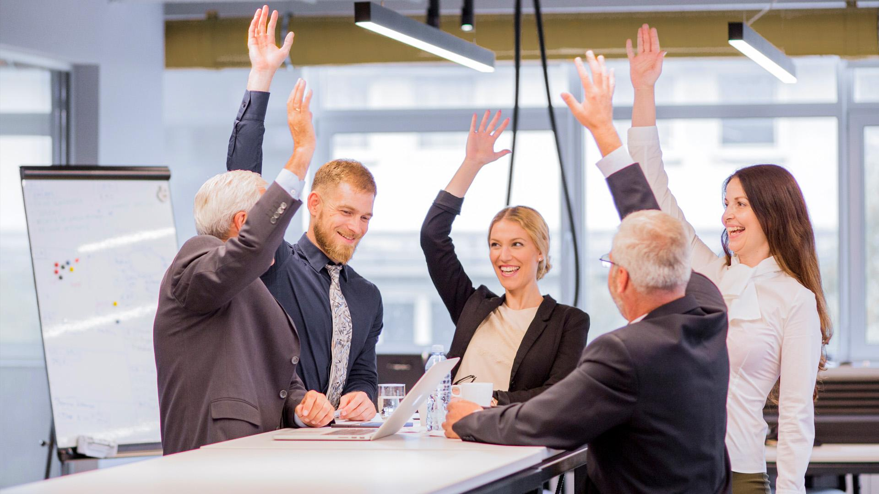
“Clara”
Q1 - “My favorite moment of the day is drinking coffee in the morning when the house is quiet”
Q2- “There is also a part of you that is like… i also want to contribute in some way. Having an impact and not just kind of being ”
Notes:
A mother of 3, working full time now. Worked part time when kids were young. Stayed at home for 5 years when eldest was in middle/high

Slide 6
“Eva”
Q1 - “Favorite part of my day is checking in with my family after dinner”
Q2- “Running in the morning sets the tone for the rest of the day”
Notes:
Coterm student at stanford, TA for a professor. At this point we had ella, grace, tamara, maria, charlie, clara, and eva and created 4 povs for each > we then selected our top three which we will go through now

Slide 7
POV: Ella
1
We Met Ella….
3
We wonder if this means…
2
We were surprised to notice…
4
It would be game changing to
a software engineer turned stay-at-home mom.
Having autonomy /variability in life is at odds with being a mother
she lives a routine and monotonous life.
empower mothers of young kids to have ownership of their own time and interests

Slide 8
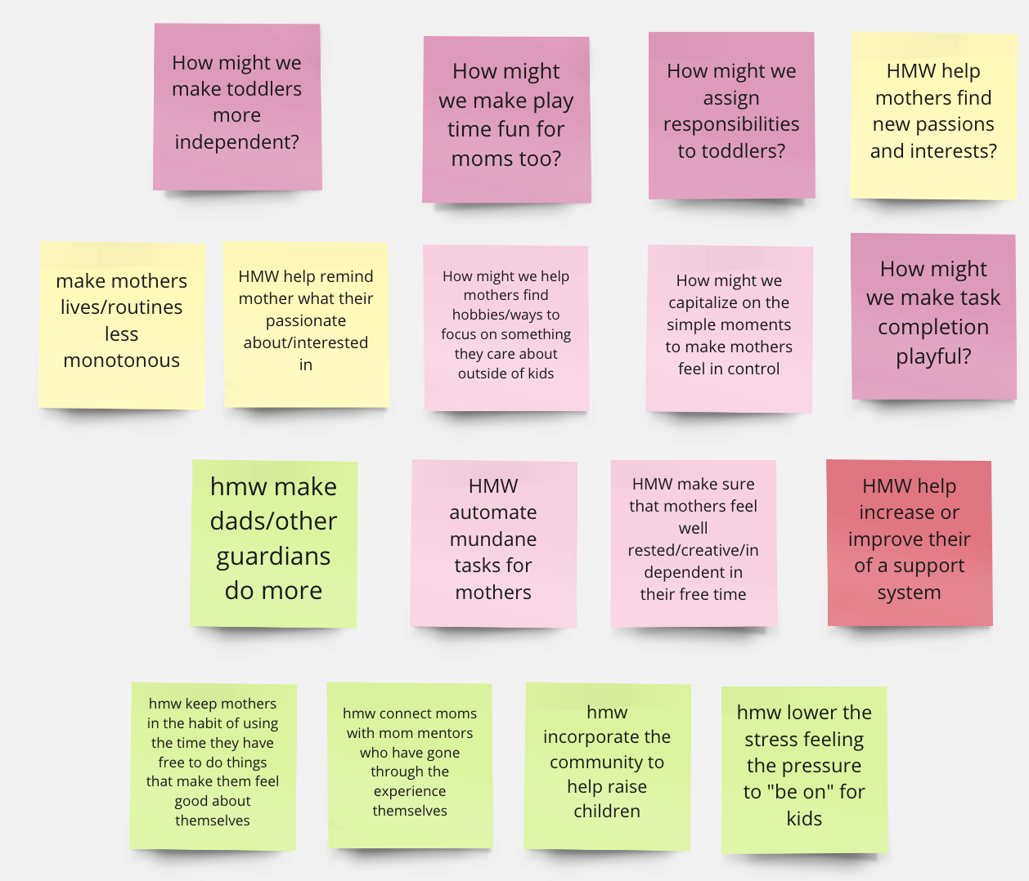
Notes:
HMWs:
How might we make toddlers more independent?
How might we make play time fun for moms too?
How might we assign responsibilities to toddlers?
HMW help mothers find new passions and interests?
make mothers lives/routines less monotonous
HMW help remind mother what their passionate about/interested in
How might we help mothers find hobbies/ways to focus on something they care about outside of kids
How might we capitalize on the simple moments to make mothers feel in control
How might we make task completion playful?
hmw make dads/other guardians do more
HMW automate mundane tasks for mothers
HMW make sure that mothers feel well rested/creative/independent in their free time
HMW help increase or improve their of a support system
hmw keep mothers in the habit of using the time they have free to do things that make them feel good about themselves
hmw connect moms with mom mentors who have gone through the experience themselves
hmw incorporate the community to help raise children
hmw lower the stress feeling the pressure to "be on" for kids

Slide 9
POV: Grace
We Met Grace...
We wonder if this means…
1
3
We were surprised to notice…
2
4
It would be game changing to
A recent college grad now working full time as a Project Engineer at Stanford while living in SF
That the structure of a stable living environment stifles personal growth
That in transitioning to living in her own apartment, she spends many hours of her day cleaning and cooking, leaving only a couple of hours of free time on weeknights
Make mealtimes and meal preparation less like a basic need and more like an opportunity for personal enjoyment
Notes:
We met Grace, a recent college graduate now working full time as a Project Engineer at the Stanford Hospital while living in SF. We were surprised to notice that in transitioning to living in her own apartment, she ends up spending many hours of her day cleaning and cooking, leaving only a couple of hours of free time on weeknights. We wonder if this means that the structure of a stable living environment stifles personal growth for personal interests. It would be game-changing to make mealtimes and meal preparation less like a basic need and more like an opportunity for personal enjoyment.

Slide 10
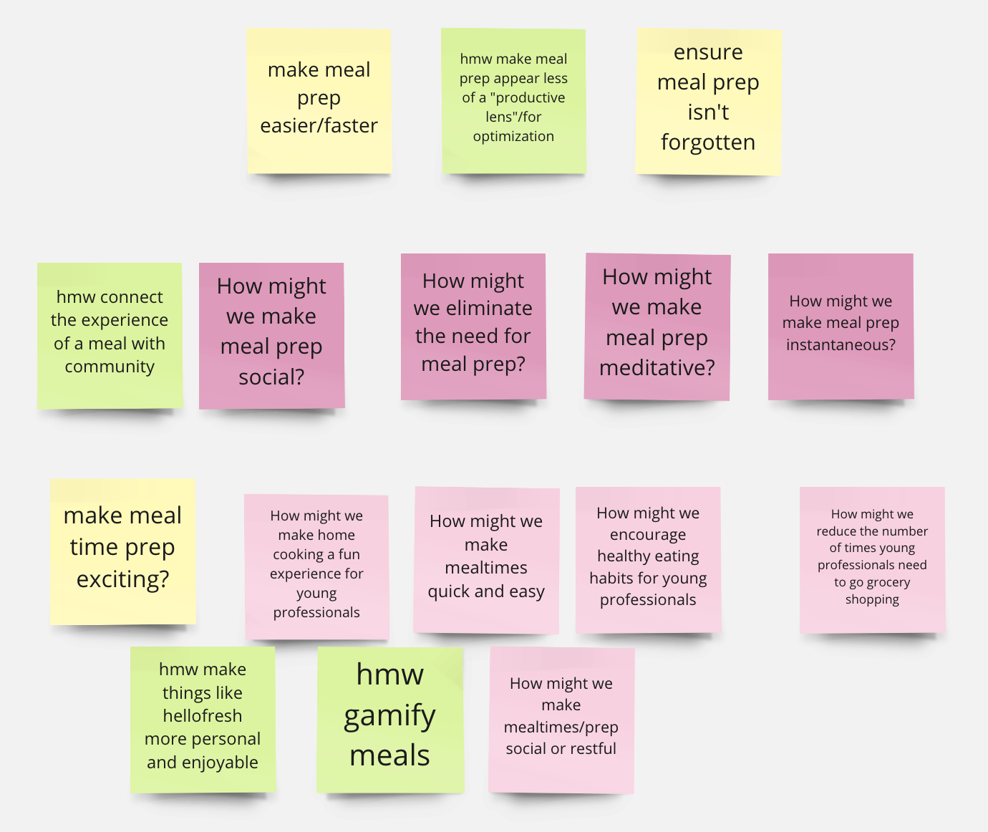
Notes:
HMWs:
make meal prep easier/faster
hmw make meal prep appear less of a "productive lens"/for optimization
ensure meal prep isn't forgotten
hmw connect the experience of a meal with community
How might we make meal prep social?
How might we eliminate the need for meal prep?
How might we make meal prep meditative?
How might we make meal prep instantaneous?
make meal time prep exciting?
How might we make home cooking a fun experience for young professionals
How might we make mealtimes quick and easy
How might we encourage healthy eating habits for young professionals
How might we reduce the number of times young professionals need to go grocery shopping
hmw make things like hellofresh more personal and enjoyable
hmw gamify meals
How might we make mealtimes/prep social or restful

Slide 11
POV: Tamara
We Met Tamara...
1
3
We wonder if this means…
2
We were surprised to notice…
4
It would be game changing to
A Sacramento salon owner, hair stylist, and single mother of three
She likes being exposed to the positive content and maintaining a positive mindset
She likes to read self-help books in her free time
Help improve and increase her exposure to positive content
Notes:
We met Tamara, a Sacramento salon owner, hairstylist, and single mother of three. We were surprised to notice she likes to read self-help books in her free time. We wonder if this means she likes being exposed to positive content and maintaining a positive mindset. It would be game-changing to help improve her exposure to positive content

Slide 12
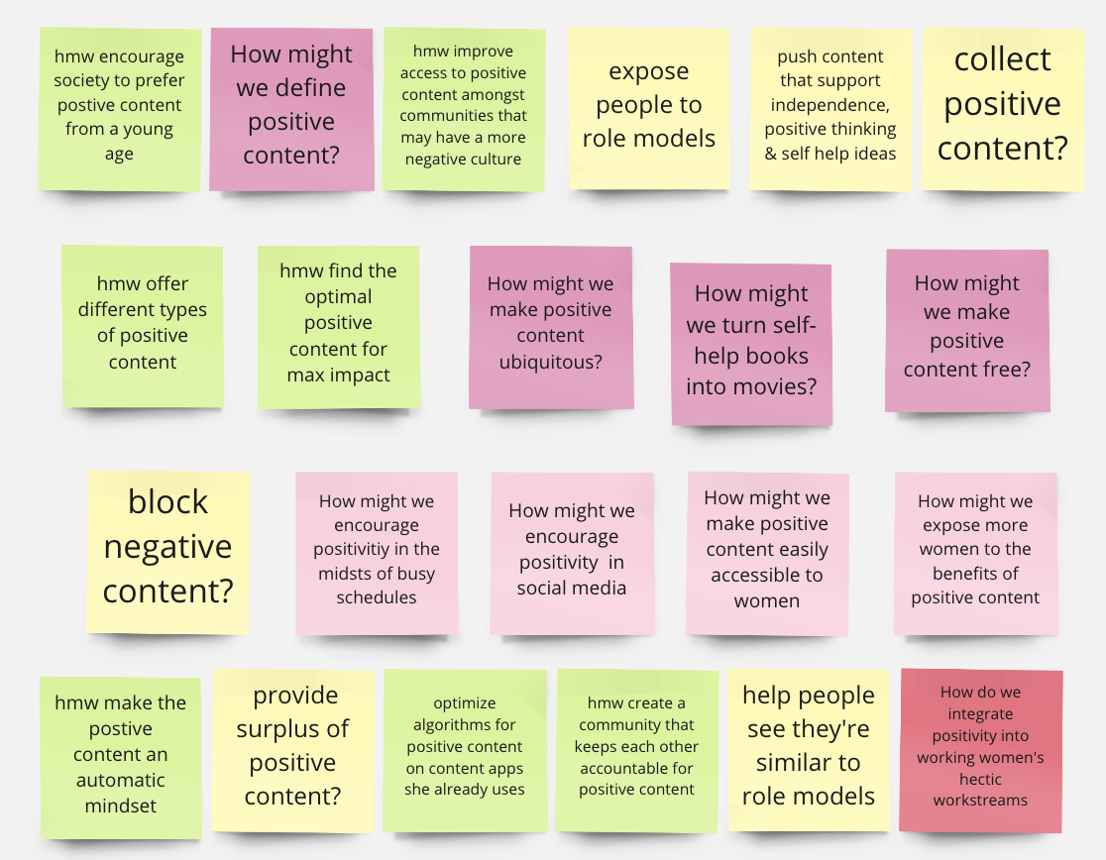
Notes:
HMWs:
hmw encourage society to prefer postive content from a young age
How might we define positive content?
hmw improve access to positive content amongst communities that may have a more negative culture
expose people to role models
push content that support independence, positive thinking & self help ideas
collect positive content?
hmw offer different types of positive content
hmw find the optimal positive content for max impact
How might we make positive content ubiquitous?
How might we turn self-help books into movies?
How might we make positive content free?
block negative content?
How might we encourage positivitiy in the midsts of busy schedules
How might we encourage positivity in social media
How might we make positive content easily accessible to women
How might we expose more women to the benefits of positive content
hmw make the postive content an automatic mindset
provide surplus of positive content?
optimize algorithms for positive content on content apps she already uses
hmw create a community that keeps each other accountable for positive content
help people see they're similar to role models
How do we integrate positivity into working women's hectic workstreams

Slide 13
Top 3 how might we…
Integrate positivity into working women's hectic workstreams?
1
Make meal time prep exciting (social/restful)?
2
Help increase or improve their support system?
3
Tamara– Salon Owner, Hair Stylist, Single Mother
Grace– First Year out of Stanford Engineer
Ella– Software Engineer turned Stay-At-Home Mom

Slide 14
Virtual Shared Journal
How might we help increase or improve their support system?
1
Solution: A social shared journal between friends/spouses to better connect and communicate

Slide 15
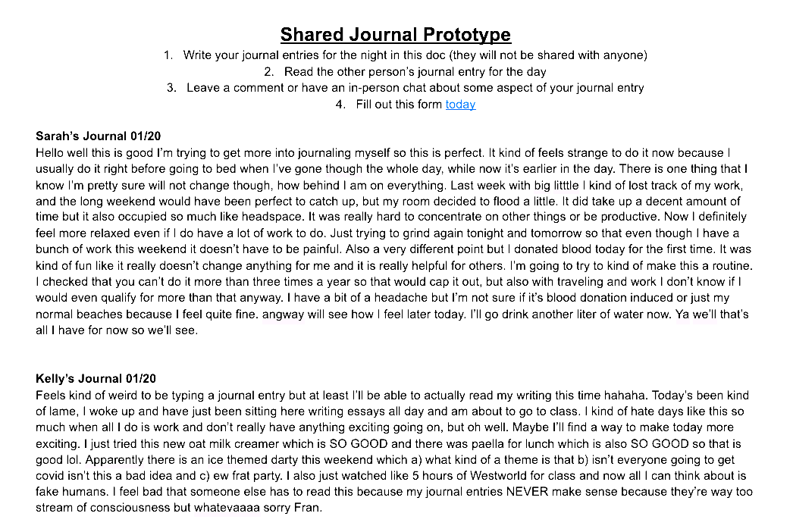
Virtual Shared Journal
Assumption: Virtual journaling is enjoyable, people empathize through reading others feelings
Participants (friends) shared a virtual journal and made comments/talked about each others their entries

Slide 16
Results and Conclusion
Valid Assumption:
people empathize through reading others feelings
Inconclusive Assumption:
People enjoy using a virtual journal
Surprised: one person liked virtual but not sharing, other liked sharing but not virtual
Learned: Sharing journals helps people to connect intimately
Notes:
Surprised: Some participants were in worse moods at lunch then at breakfast
Learned: Moods may be boosted higher with music catered to the individual
Worked: Learned people preferred music at their meals
Didn’t Work: Ideally would have compared the same meal with and without music

Slide 17
Social Cooking Platform
How might we make meal time exciting (social/restful)?
2
Solution: Create a social platform that incorporates shared listening experiences during meal time.

Slide 18
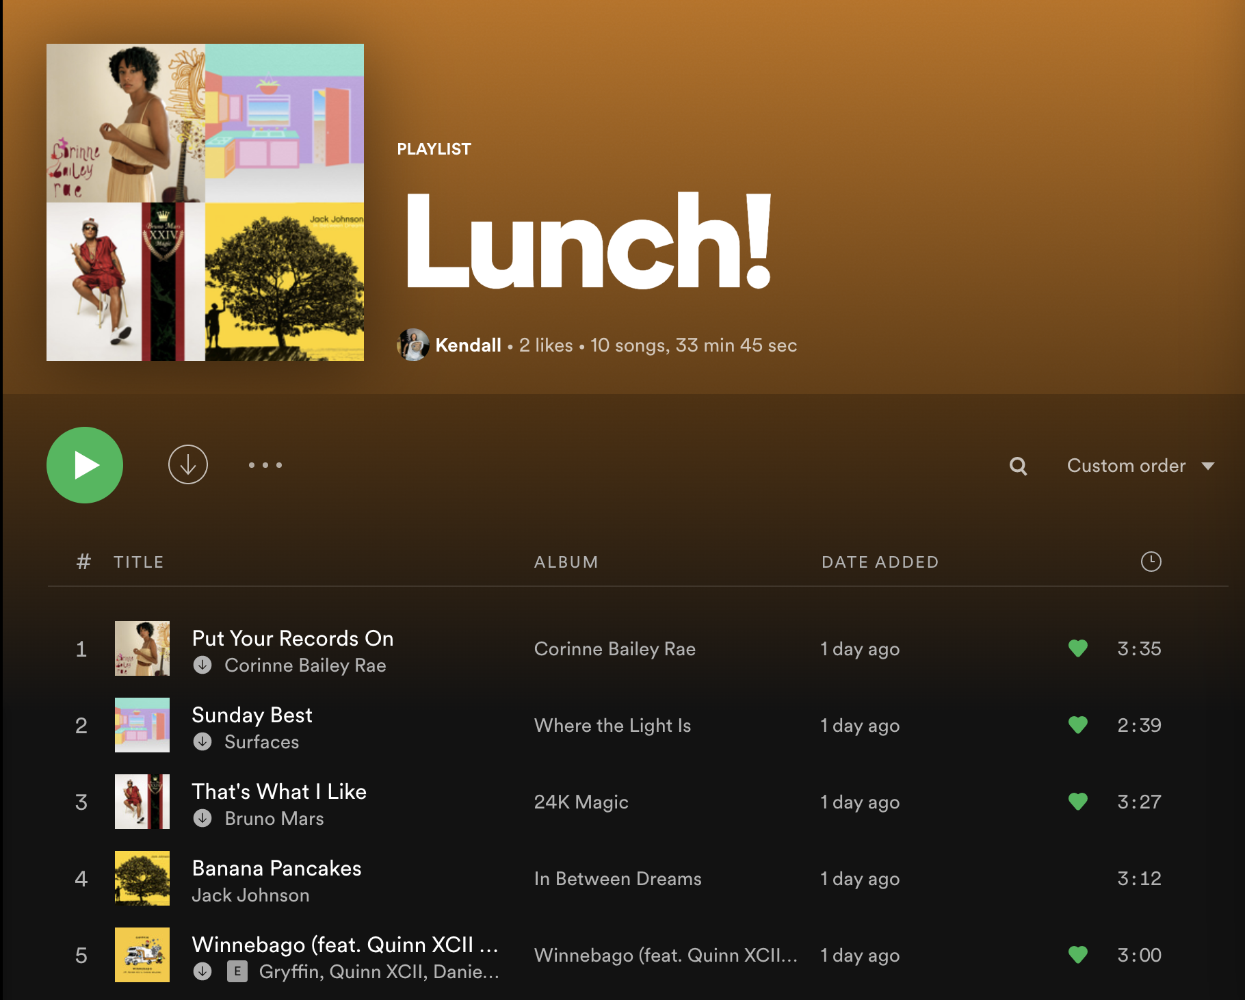
Music as a Meal Mood Booster
Assumption: Listening to music would make meal time more enjoyable.
Participants listened to an upbeat playlist while eating and reported their mood before & after the meal

Slide 19
Results and Conclusion
Surprised: worse pre meal mood at lunch than at breakfast
Learned: Catered music could boost mood higher
Valid Assumption:
Participants experienced better moods after listening to the playlist over meals
Worked: People preferred music at lunch
Didn’t Work: Should have compared the same meal
Notes:
Surprised: Some participants were in worse moods at lunch then at breakfast
Learned: Moods may be boosted higher with music catered to the individual ex) church music or repeat songs from Lunch!
Worked: Learned people preferred music at their meals
Didn’t Work: Ideally would have compared the same meal with and without music

Slide 20
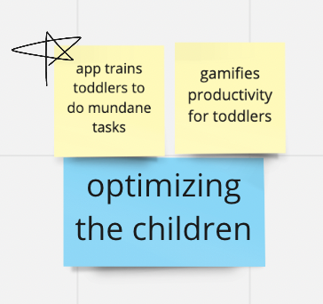
Support System Platform
Help increase or improve their support system?
3
Solution: Build an app to help caretakers delegate tasks and help children/dependents perform tasks

Slide 21
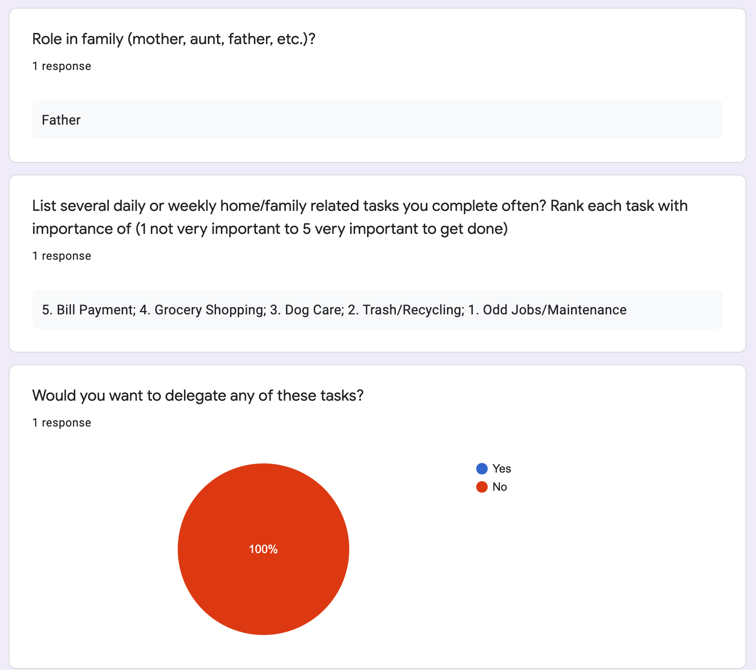
Household Task Delegation
Assumption: parents want help with household/family tasks
Participant (father of a toddler) filled out Google Form asking about home/family tasks and if they’re willing to delegate tasks
Ideally would’ve wanted a female participant as well

Slide 22
Results and Conclusion
Invalid Assumption:
Parents want to delegate household/family tasks
New Assumption:
Parents feel responsible for their family and aren’t eager to delegate their responsibilities to their kids/partners
Surprised: no desire to delegate
Learned: Child dependents may struggle doing many of the tasks mentioned
Worked: Learned about types of family/home tasks (Bills, Groceries, Dog Care)
Didn’t Work: Should’ve asked why they would/wouldn’t want to delegate tasks
Notes:
Testers: Father with 11 month old daughter

Slide 23
Social Cooking Platform
v

Slide 24
Balance
Moments of Bliss
A Different ‘Productivity’
i
Working women are expected to balance home and work life with ease. They feel a need to “do it all”.
A morning coffee, waiting for the kids, watching TV before bed
It’s productive to take care of yourself, to balance work and life, to prioritize moments of bliss

Slide 25
Next Steps
Hone in on solution
Video Prototype
Test more experiences
Storyboard

